Slide 1





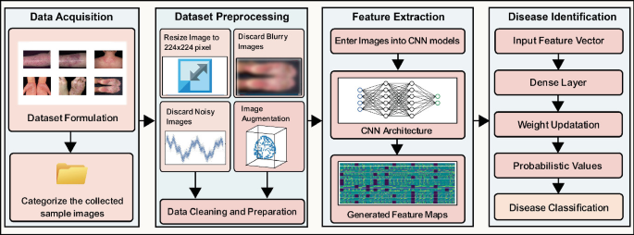
A I D I A
PE Id: PE202513
SKIN DISEASE CLASSIFICATION
Problem Statement:
Objective:
Develop an accurate and efficient CNN based system for the classification of skin diseases from digital images.
The objective of skin disease classification using CNN is to develop an accurate and efficient computer-aided diagnostic system that can assist dermatologists in the early and precise identification of various skin diseases from digital images.
Conceptual Design:
Solution & Specifications:
Results:
1. Data Collection and Preprocessing: Data Set is collected from Kaggle.
2. CNN Architecture:
Convolutional ,Pooling and Dense
Layers are applied
Training and Optimization:
The model is trained using fit function.
4. Evaluation and Validation:
The model's performance is evaluated on the validation set using metrics like accuracy, precision etc.
-Hardware
Sufficient RAM for handling large data -Software
Deep Learning Framework(TensorFlow and Keras)
Python Libraries(NumPy and Matplotlib)
Optimizers(Adam) -Model Architecture CNN
An Accuracy of 72.9% is achieved.. Early detection of skin disease improves the treatment outcomes.
Future Scope:
Department:
CSE (AI&ML)
Team Members:
A Jashwanth 245523748071
S Chinmayee 245523748083
K Sai Vamshi 245523748097
M Sri Sreshta 245523748103
P Sri Kruthin 245523748111
Anil Rathod 245523748310
1. Enhanced Data Quality and Quantity 2. Advanced CNN Architectures 3. Mobile and Teledermatology Applications 4.Ethical Considerations
Guide:
T. Gayathri ,
Assistant Prof.

